Slide 1

Top’t Corn
Decadent popcorn with capitol toppings

Slide 2
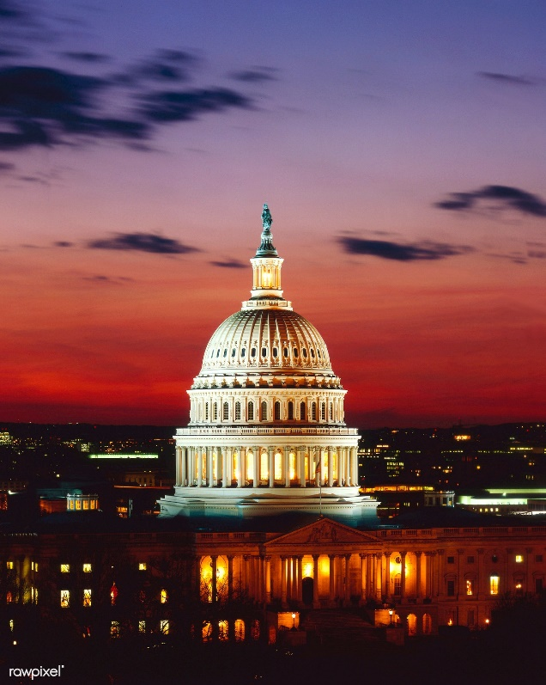
Overview
Founded in 2006 in Washington DC
Family owned and operated
Serving the greater Washington DC area including Northern Virginia and Maryland

Slide 3

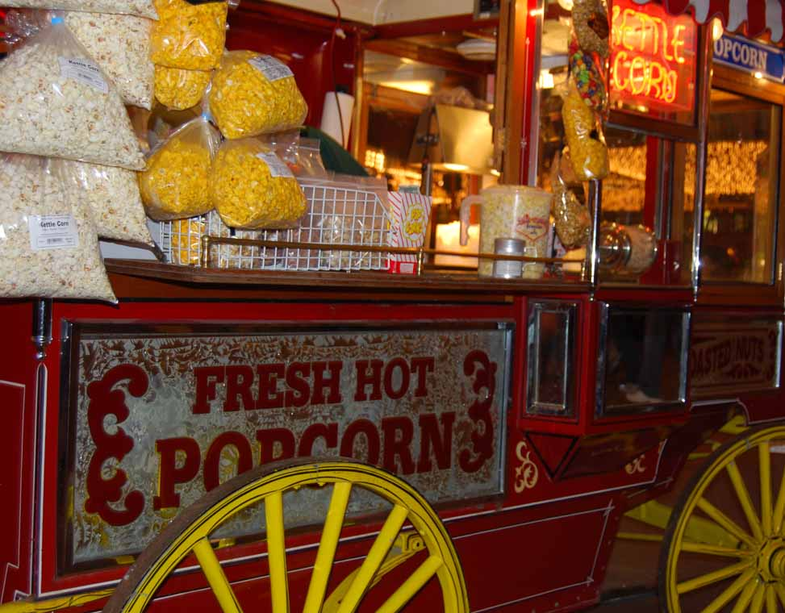
Goals
Unique and delicious flavor profiles
Affordable prices for families
Easy access locations for quick purchasing

Slide 4

Our Top’t 4 Sellers
Original Blend
Old Bay
Sea Salt and Caramel
Truffle

Slide 5

Future Flavors
Spicy Cheddar
Candied Bacon
Matcha
Red Velvet

Slide 6
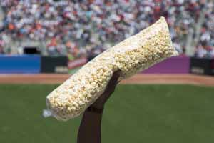
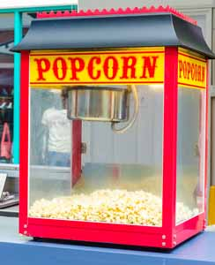
Brick and Mortar Stores
National Harbor
Old Town Alexandria
Nationals Park
Mosaic District

Slide 7


Food Truck Locations
The Wharf
Georgetown
K Street

Slide 8
Food Truck Monthly Sales Sample
 | Farragut Square | Georgetown | The Wharf
Old Bay | 2120 | 995 | 1485
Truffle | 2360 | 1065 | 2105
Sea Salt and Caramel | 2335 | 1195 | 1870

Slide 9
October Sales Totals

Slide 10

Pricing
Price per box $10
Commemorative packaging $4
DIY Toppings $3
Notes:
Contact Tom Finley for custom pricing

